Slide 1
Analysis of Propane Gas Fire Experiments and Simulations in Residential Scale Structures
Joseph M. Willi
Master of Science Thesis Defense
May 5, 2017

Slide 2
Overview
Introduction
Experimental Setup
Experimental Procedures
FDS Simulation Description
Results and Discussion
Summary

Slide 3
Introduction
Nine experiments in two structures
Numerous types of measurements
FDS (version 6.5.3) simulations of each experiment
Significant addition to validation guide
Notes:
Experiments apart of larger set of tests; 53 FDS experiments, handful are in residential size structures, none in two-story
-- Picture of smokeview model; burner model
-- Difference between verification validation

Slide 4
Experimental Setup

Slide 5
Test Structures
Interlocking concrete block walls
Steel studs set to 16” centers
Two layers of 5/8” Type X gypsum board
Layer of ½” Durock cement board on top of gypsum board
Ceiling covered by two layers of 0.5 in. durock board
Wood truss joist I-beams ceiling

Slide 6
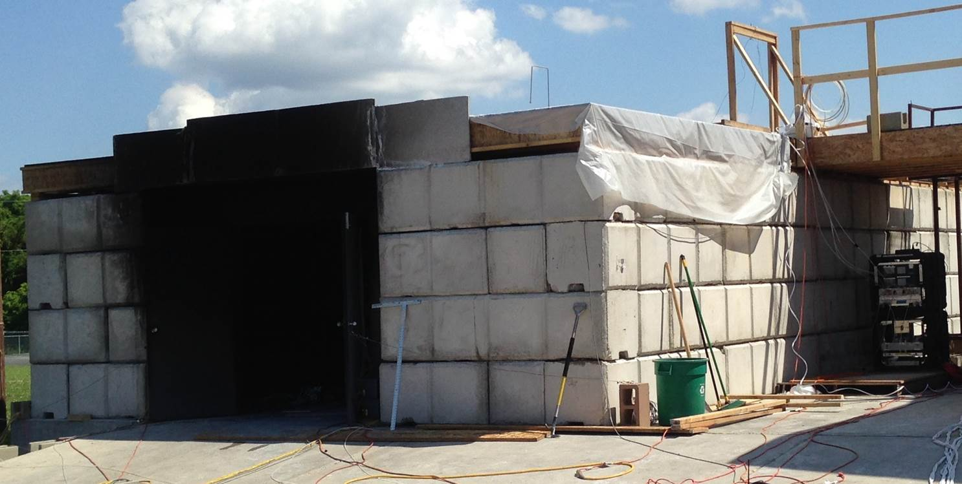
East Structure
Notes:
Highlight 2x2x4 blocks, single story, picture is of the north side

Slide 7
East Structure
Notes:
Entire structure - 24’x40’
Front and back rooms – 20’x12’, middle room 12’x10’
highlight doorways, sealed off room, ceiling height

Slide 8
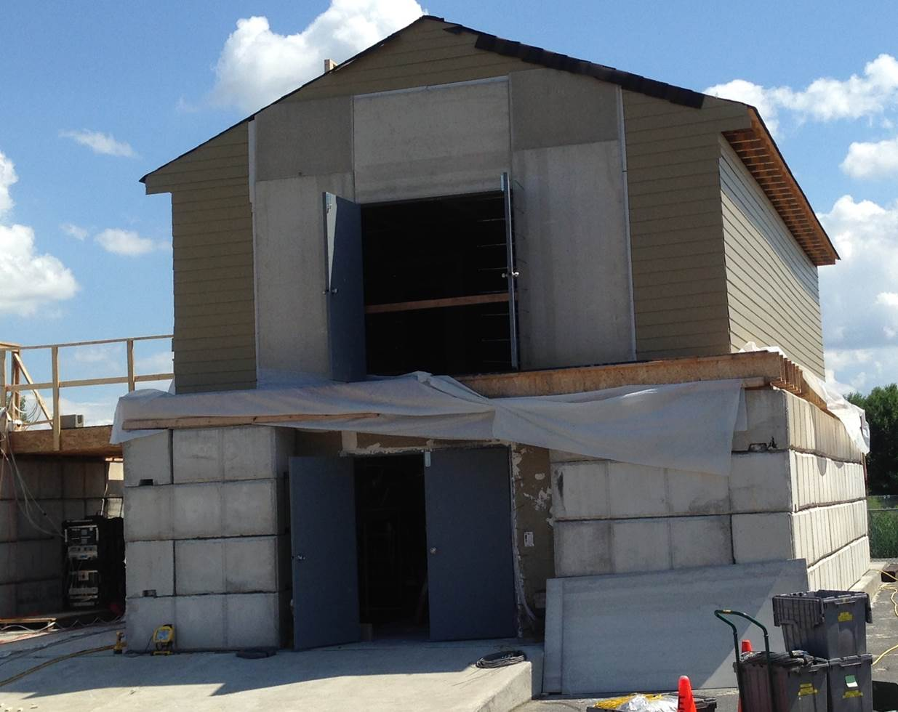
West Structure
Notes:
-- North side of structure; big differentiating factor between this and east structure is second story
-- notice ground floor similar to single-story structure 2x2x4 blocks, double doors on north side
--

Slide 9
West Structure – 1st Floor
Notes:
English units, designed like basement with walk out doors, stairs
7.25” rise/7.5” run
39’ x 23’ => interior space ~ 35’x 16’

Slide 10
West Structure – 2nd Floor
Notes:
0.8 m => 32” door
0.9 m => 36” door
Walls wood framed with 2x4s set to 16 in centers, two layers of 5/8” Type X gypsum board with a layer of ½” Durock cement board on top
Outer walls on 2nd floor had 7/16” OSB and 5/16” fiber cement lap siding

Slide 11
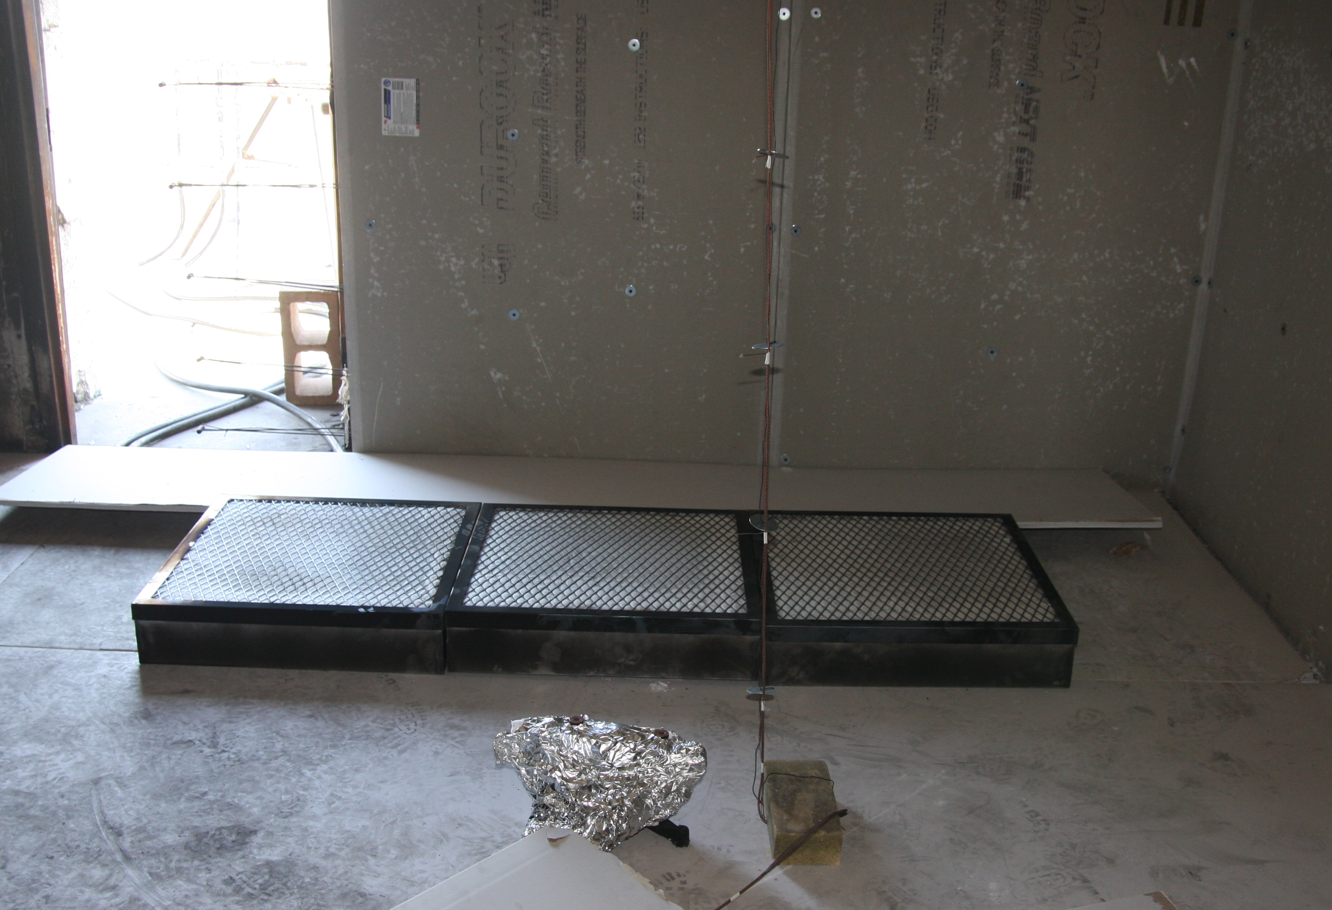
Fire Source
Three propane gas burners
Notes:
2’ x 2’ about 6” above the ground

Slide 12
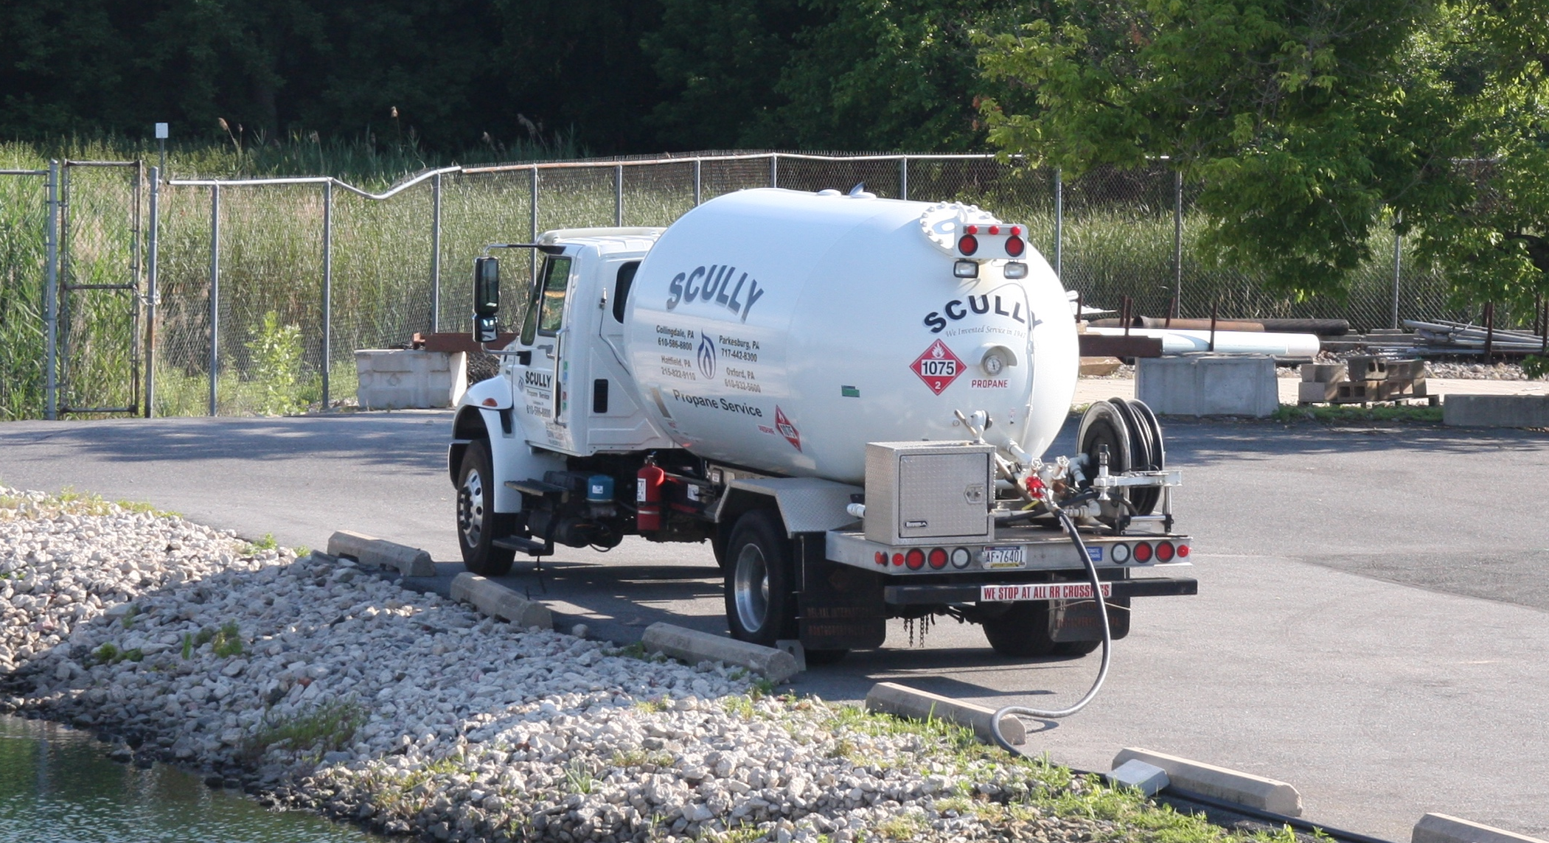
Fire Source
Provided by propane supply truck
Notes:
Propane supply for commercial industrial applications

Slide 13
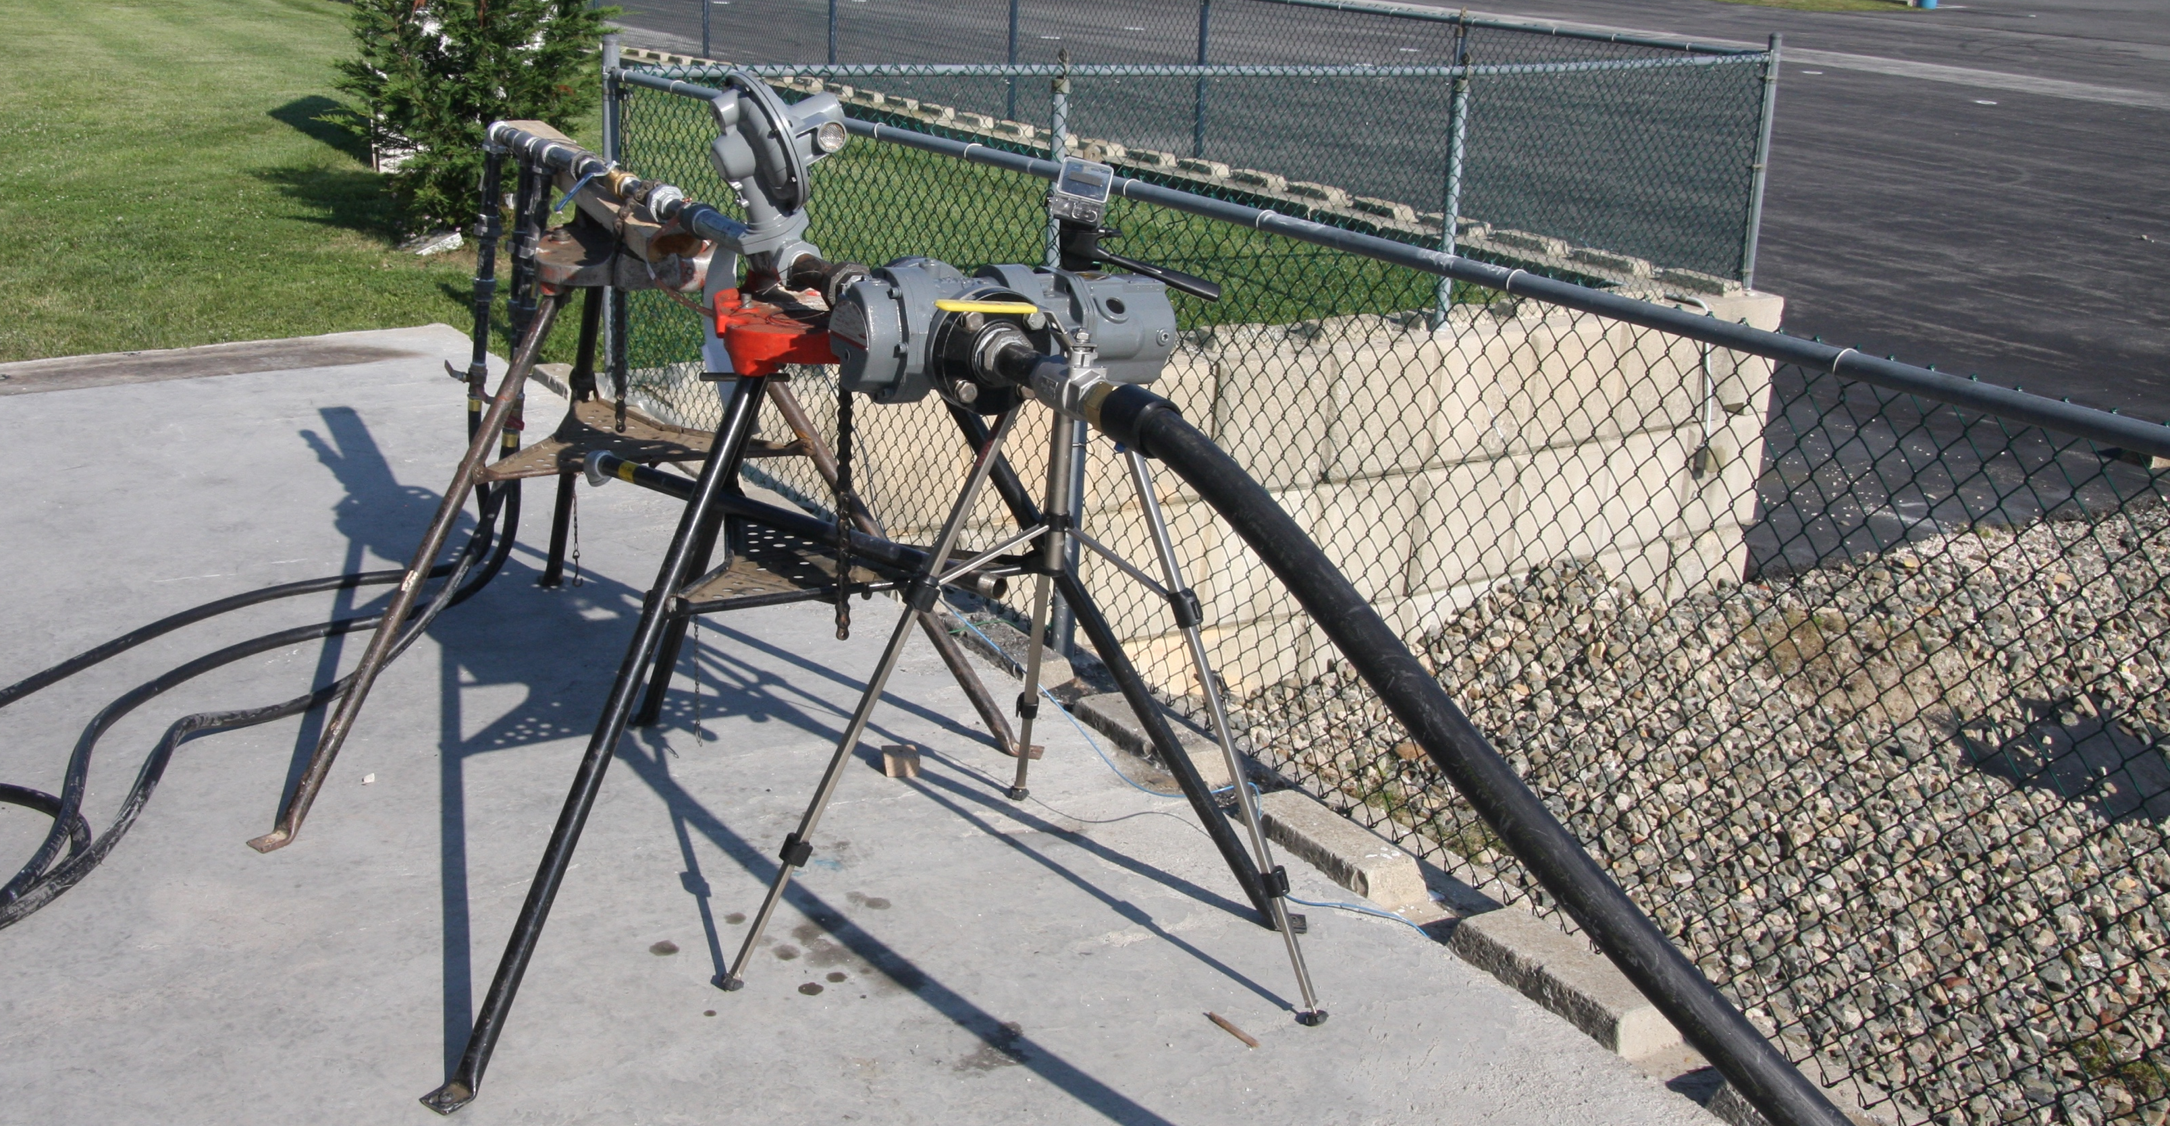
Fire Source
Controlled and measured at rotary gas meter
Notes:
Zoom into each part of apparatus

Slide 14
Fire Source
Uncertainty analysis
Notes:
Add picture of meter and truck

Slide 15
Instrumentation
Thermocouples
Gas species concentrations
Bi-directional Probes
Heat flux gauges
Notes:
Floor plans with each type of instrumentation highlighted, uncertainty described

Slide 16
Experimental Procedures

Slide 17
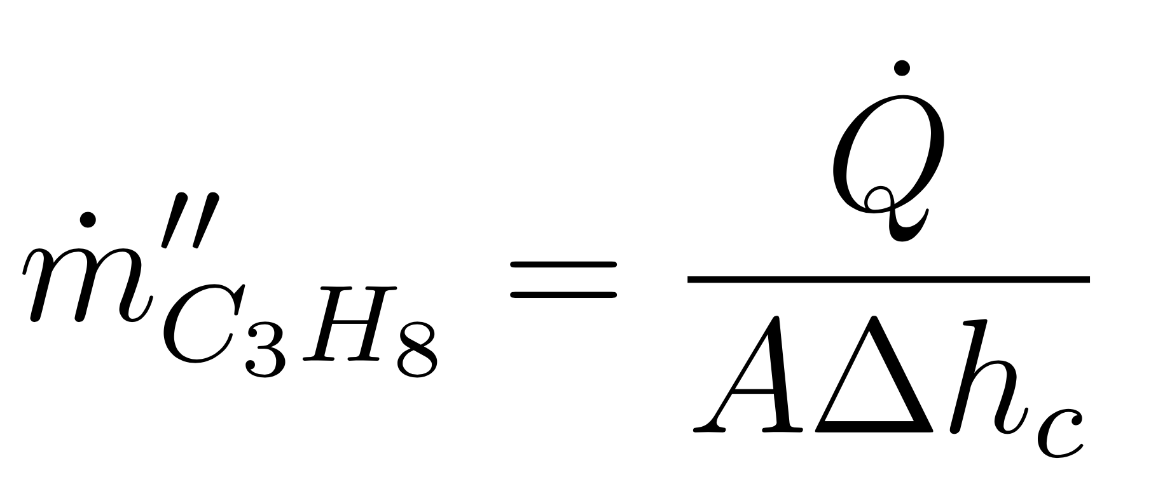
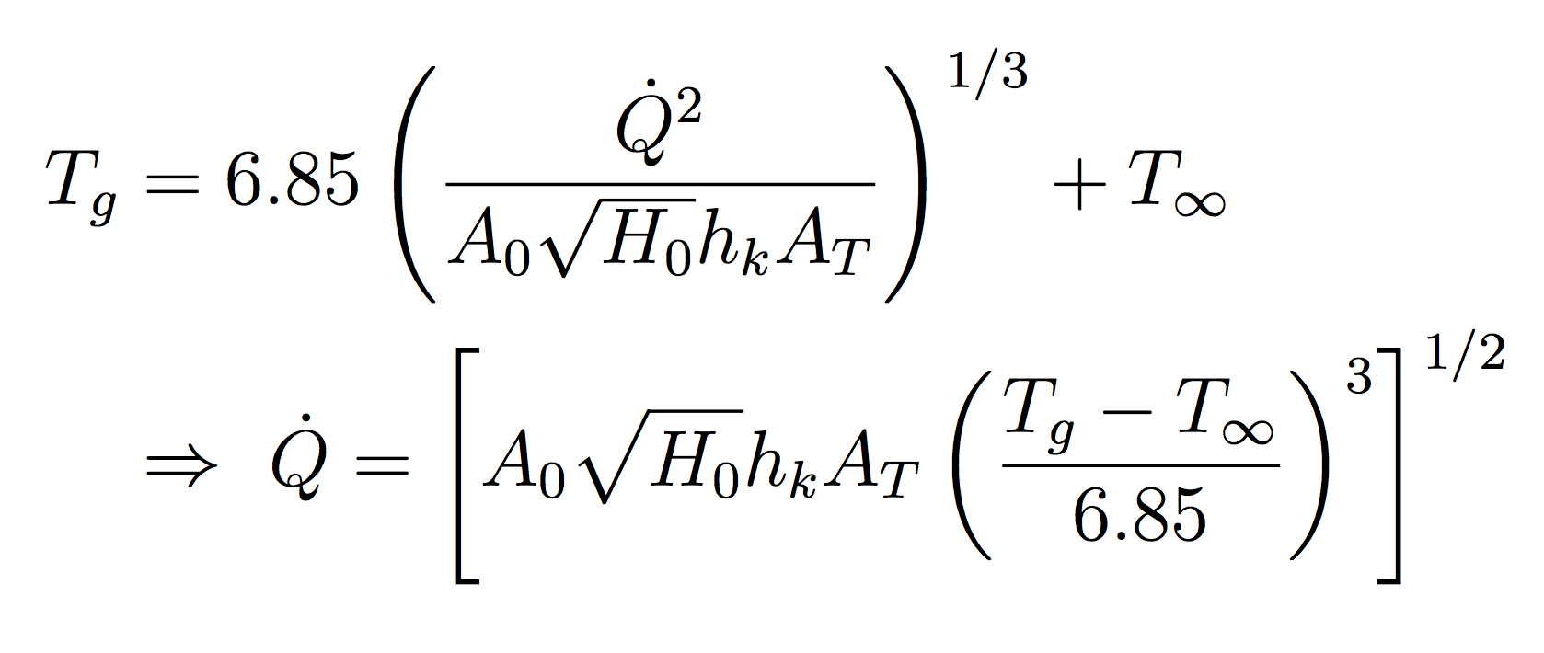
Tests 2-4

Slide 18
Tests 2-4
Notes:
~ 3 minutes between burner ignitions
About 60 seconds til first door
2 minutes until 2nd double door
60 seconds until rear door

Slide 19
Tests 2-4
Notes:
~ 2 minutes between south door and first burner off
~ 2 minutes between next burners being extinguished
~ PPV after the test to help cool down structure

Slide 20
Tests 5 & 6
Three “sequences” per test
Use of roof vent and double doors
All burners ignited at once

Slide 21
Test 5

Slide 22
Test 5

Slide 23
Test 6

Slide 24
Test 6

Slide 25
Tests 22-25
Three “sequences” per test
Use of roof vent and double doors
All burners ignited at once

Slide 26
Tests 22 & 23

Slide 27
Tests 24 & 25

Slide 28
FDS Simulation Description

Slide 29
Computational Domain
East Tests: (x, y, z) → (14 m, 8 m, 3 m)
West Tests: (x, y, z) → (14 m, 8 m, 5.4 m)
Eight equally sized meshes
Notes:
-- Smokeview pictures; grid
-- Equally sized meshes per simulation to utilize MPI-parallell processing on multi-processor Linux machine

Slide 30
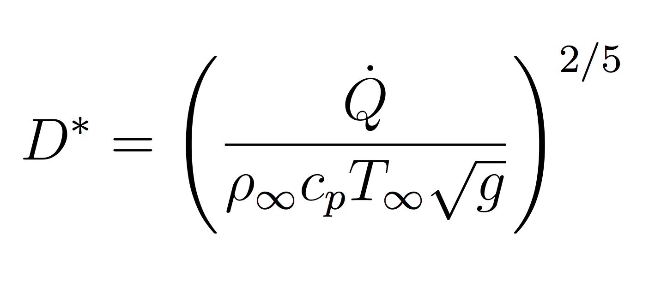
Mesh Sensitivity Analysis
Coarse (14 cm), medium (10 cm), fine (7 cm or 5 cm)

Slide 31

Source Fire Characterization
Steel sides, top surface specified mass flux of propane
Single-step reaction mechanism
Notes:
-- Reaction mechanisms for combustion in all simulations default mixing controlled, simple chemistry model

Slide 32
Timing Information
Vents modeled

Slide 33
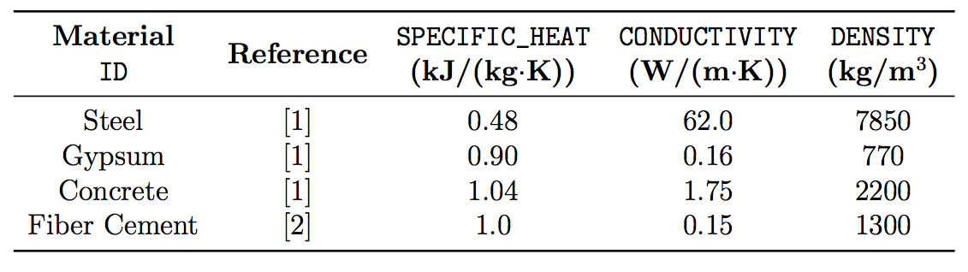
Defined Materials
Four materials were defined using MATL namelist group

Slide 34
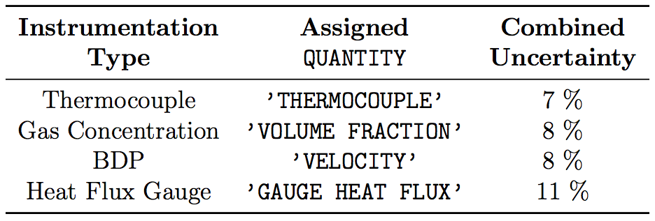
Defined Instrumentation
Instrumentation defined using FDS devices

Slide 35
Results and Discussion

Slide 36
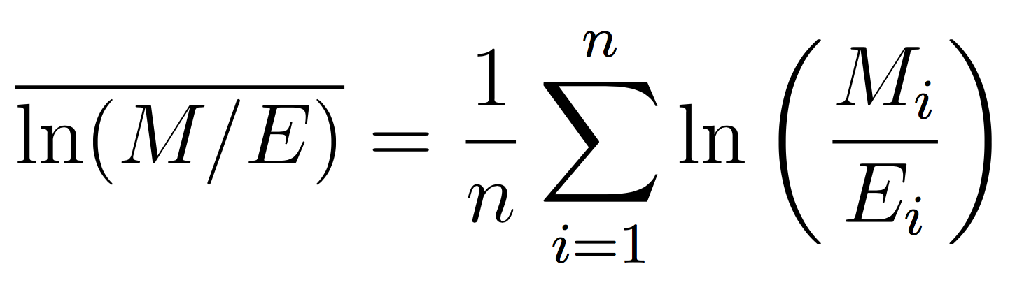
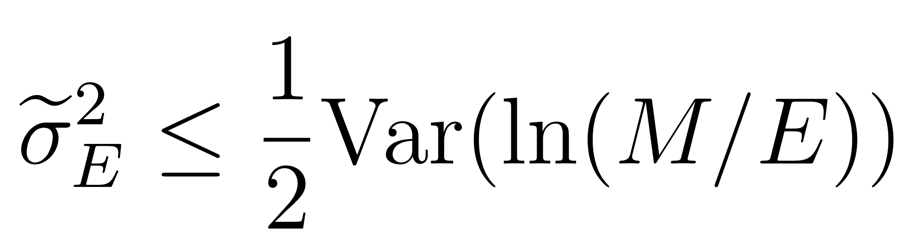
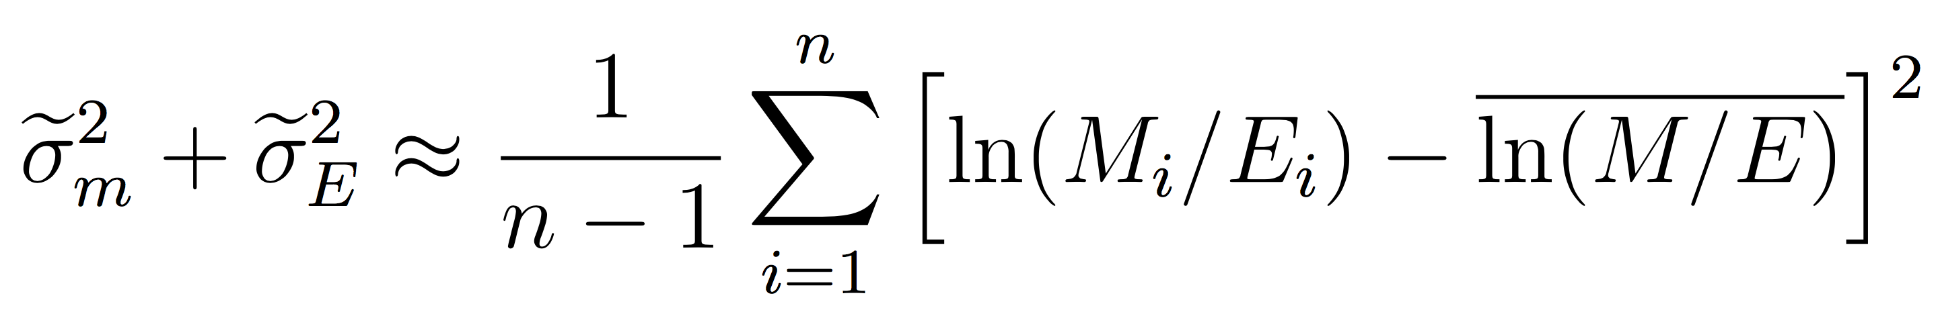
Summary Plots

Slide 37
Conclusion

